Slide 1
Paper Nine: English Phonetics and Linguistics
Classification of Vowel Sounds
by
Dr. Prithiviraj Singh Chauhan

Slide 2
Classification of vowels sounds
What is vowel sound?
“a speech sound produced by humans when the breath flows out through the mouth without being blocked by the teeth, tongue, or lips:” https://dictionary.cambridge.org/dictionary/english/vowel
During the articulation of vowels sound there is no obstruction in mouth and air passes without any friction
Vowels are articulated with open approximationts.

Slide 3
Criteria involved in classification of Vowels
Part of tongue raised to produce sound: front, central and back
Height of the tongue: Close, half close, half open and open
Position of lips: rounded , unrounded

Slide 4
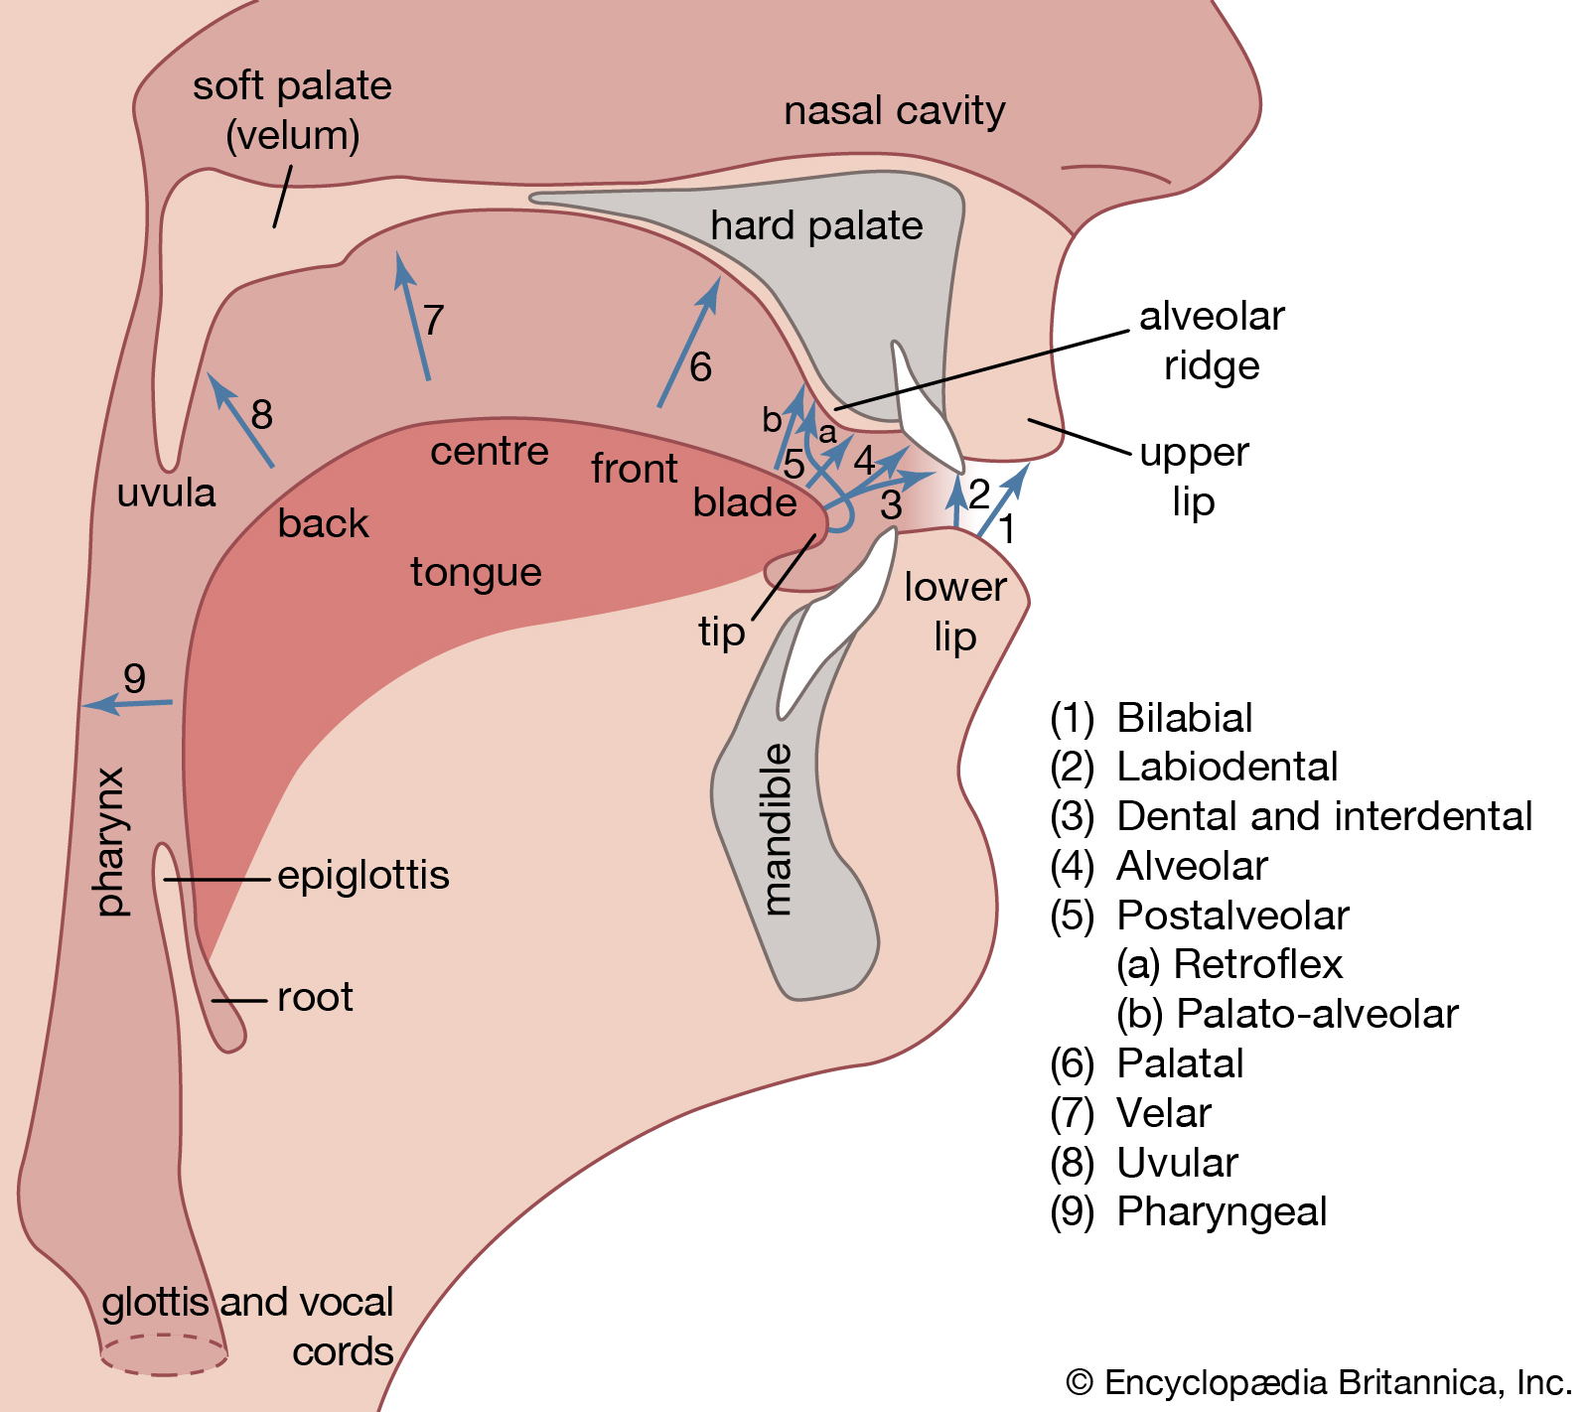
Part of tongue: front, central and back
PC: https://www.britannica.com/science/phonetics

Slide 5
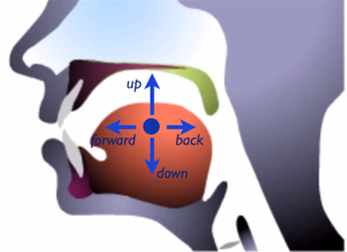
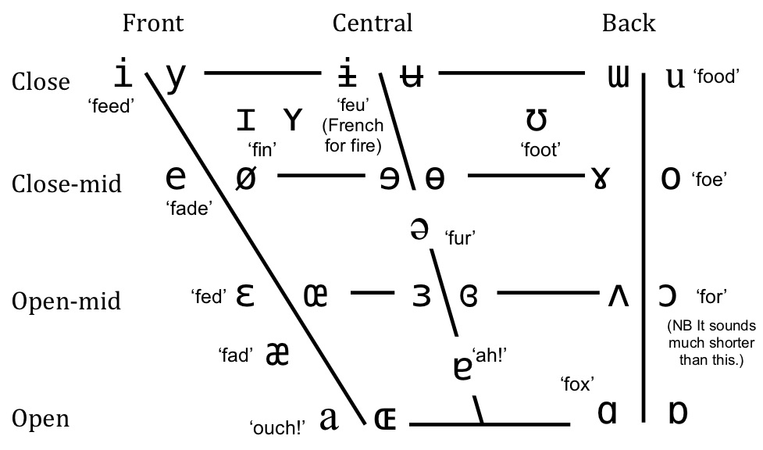
Height of tongue: Close, half close, half open and open
PC:http://english.mimicmethod.com/english-vowels.html
PC: https://www.oxfordsinginglessons.co.uk/vowel-sounds-and-mouth-positions/

Slide 6
Position of lips: rounded , unrounded
PC: https://www.slideshare.net/maryjanecells778/lesson1-vowel-sounds

Slide 7
Tongue Position: Close, half close, half open and open, Lip position: rounded, unrounded
Cardinal Vowel | Tongue position | Lip Position | Example
i | Front close | unrounded | bid
e | Front half close | unrounded | bed
ɛ | Front half open | unrounded | fed
a | Front open | unrounded | ouch
ɑ | Back open | unrounded | fax
ɔ | Back half open | rounded | for
o | Back half close | rounded | foe
u | Back close | rounded | food

Slide 8
Vowel description: Cardinal and secondary cardinal
PC: https://slideplayer.com/slide/9679497/

